Slide 1
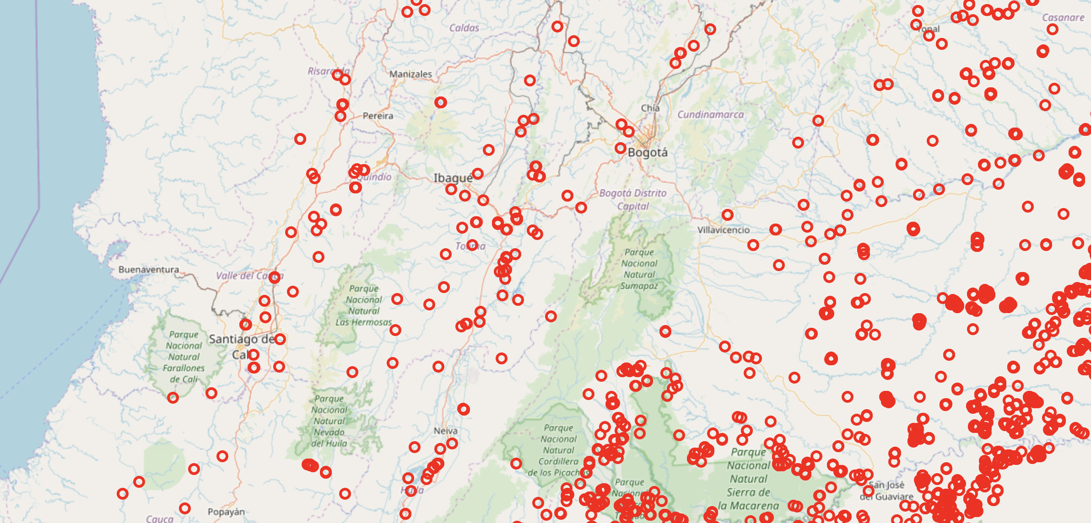
Tracking fires worldwide
March 9th
Juliana Aguilar
Lucía Delgado
Jorge Quintero

Slide 2
Goal
Provide an interactive platform that allows fire tracking around the globe with updated information.
Identify fires that are within a certain radius of human settlements.

Slide 3
Why is this useful?
Provide an easy way to visualize fires detected by satellites at the country level.
Track population displacement involving village burning in conflict zones.
Identify fires close to human settlements to prevent and better allocate resources to stop wild fires.

Slide 4
Structure
MAP
Feature Selection:
Country
Time Frame
Fire Confidence
Additional information:
Ratio of Area with human settlements within a radius r around the fire
Daily updated fire data from NASA
Human settlements raster data

Slide 5
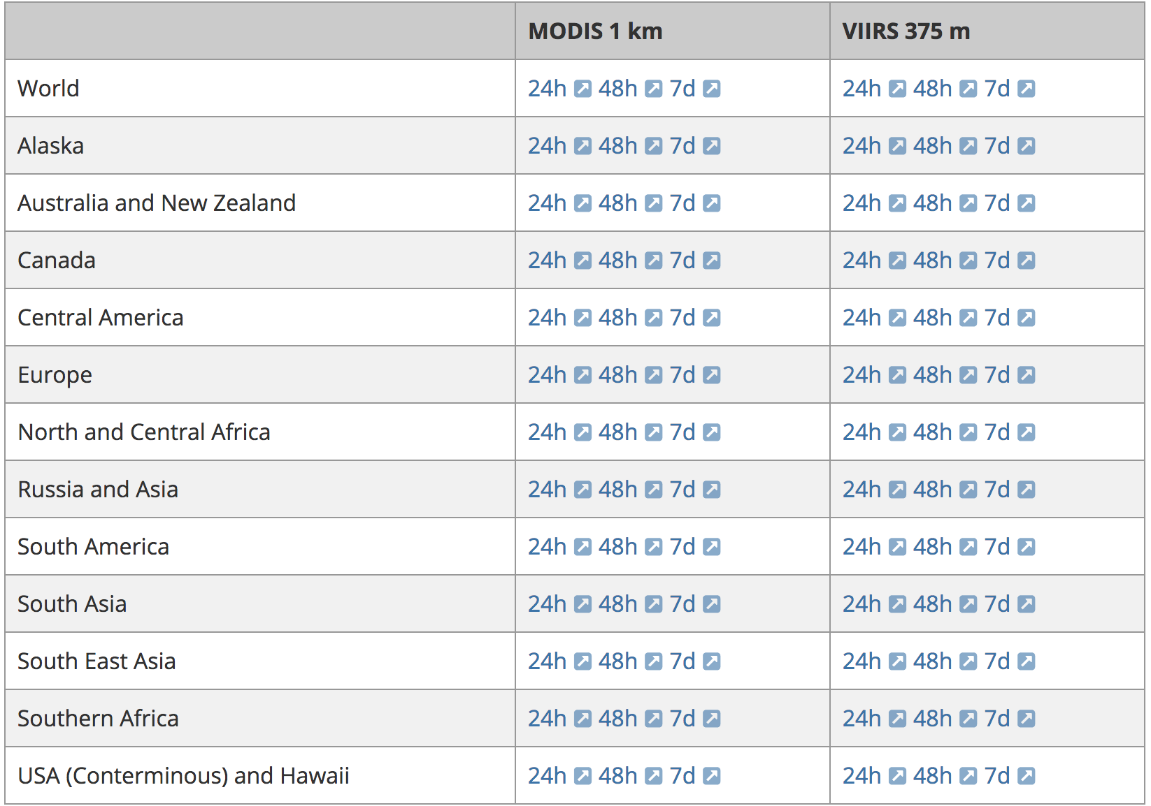
Fires data (data_downloader.py)
Table from NASA website
Built a soup
Downloaded and stored daily data
Created a file dictionary to be used later
Source: earthdata.nasa.gov

Slide 6
Global Human Settlements
Cuts raster data for each country
Overlaps with fire data set
Takes mean settlement values in a buffer around each fire

Slide 7
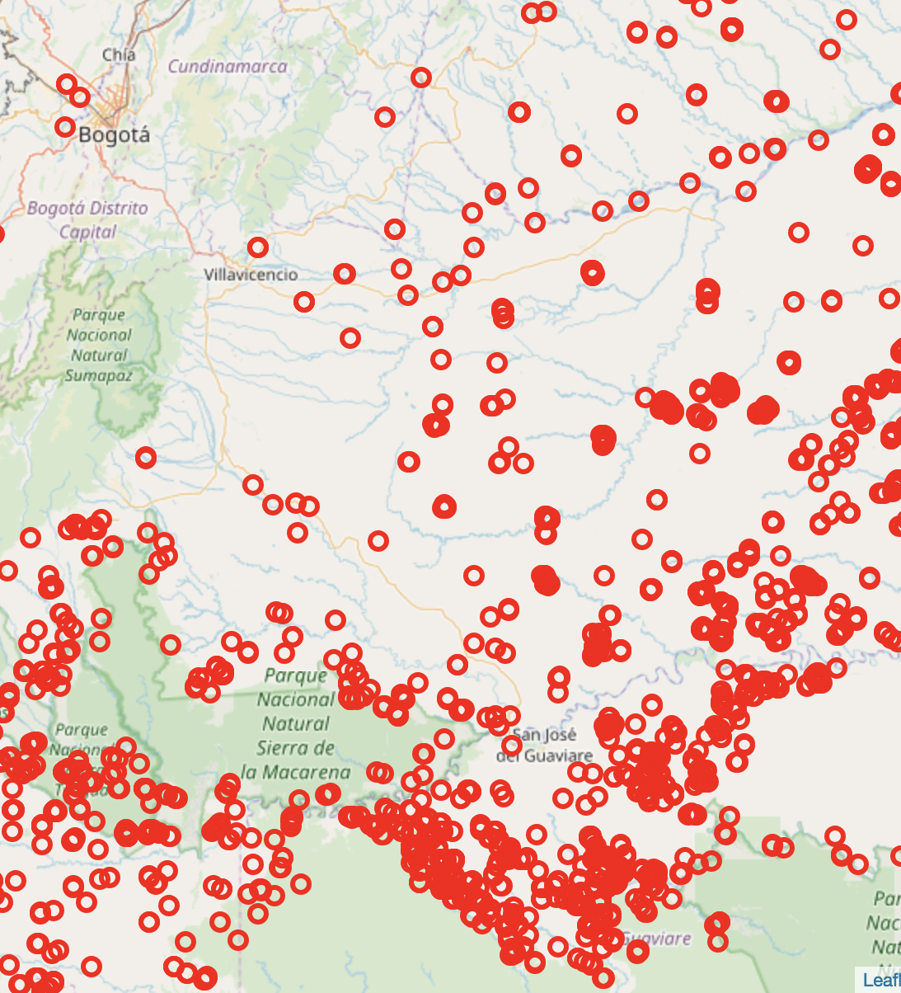
Maps
Example of fire map (Colombia)
Select data for a given country, time frame and confidence
Generate interactive map (html)
Use Django to display maps
GeoPandas, Cartopy
GeoJson, Folium
Django, GeoDjango, Leaflet

Slide 8
Results
Updated fire maps at the country level.
Identification of fires close to the human settlements for Colombia.

